Slide 1
Matrix Eigenvalue Problems

Slide 2
A matrix eigenvalue problem considers the vector equation
(1) Ax = λx.
Here A is a given square matrix, λ an unknown scalar, and x an unknown vector. In a matrix eigenvalue problem, the task is to determine λ’s and x’s that satisfy (1). Since x = 0 is always a solution for any and thus not interesting, we only admit solutions with x ≠ 0.
The solutions to (1) are given the following names: The λ’s that satisfy (1) are called eigenvalues of A and the corresponding nonzero x’s that also satisfy (1) are called eigenvectors of A.
Section 8.0 p‹#›
Notes:
‹#›

Slide 3
The Matrix Eigenvalue Problem. Determining
Eigenvalues and Eigenvectors
Section 8.1 p‹#›

Slide 4
We formalize our observation. Let A = [a_{jk}] be a given nonzero square matrix of dimension n × n. Consider the following vector equation:
(1) Ax = λx.
The problem of finding nonzero x’s and λ’s that satisfy equation (1) is called an eigenvalue problem.
Section 8.1 p‹#›

Slide 5
We introduce more terminology. A value of λ for which (1) has a solution x ≠ 0 is called an eigenvalue or characteristic value of the matrix A. Another term for λ is a latent root. (“Eigen” is German and means “proper” or “characteristic.”)
The corresponding solutions x ≠ 0 of (1) are called the eigenvectors or characteristic vectors of A corresponding to that eigenvalue λ. The set of all the eigenvalues of A is called the spectrum of A. We shall see that the spectrum consists of at least one eigenvalue and at most of n numerically different eigenvalues. The largest of the absolute values of the eigenvalues of A is called the spectral radius of A, a name to be motivated later.
Section 8.1 p‹#›

Slide 6
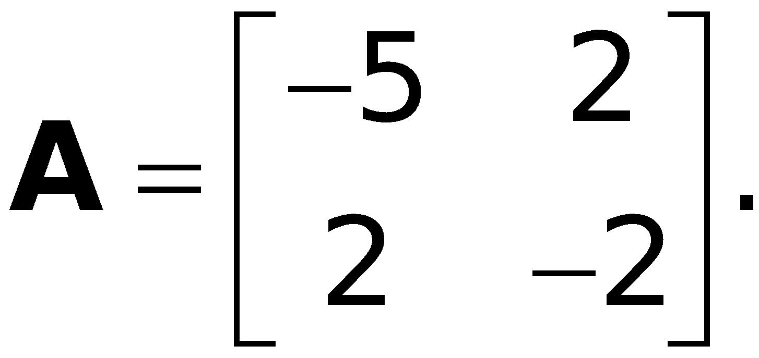
How to Find Eigenvalues and Eigenvectors
EXAMPLE 1
Determination of Eigenvalues and Eigenvectors
We illustrate all the steps in terms of the matrix
Section 8.1 p‹#›

Slide 7
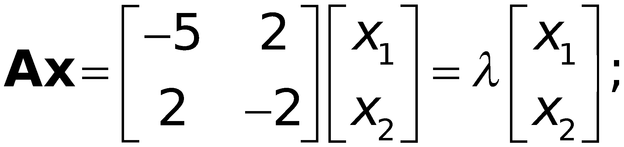
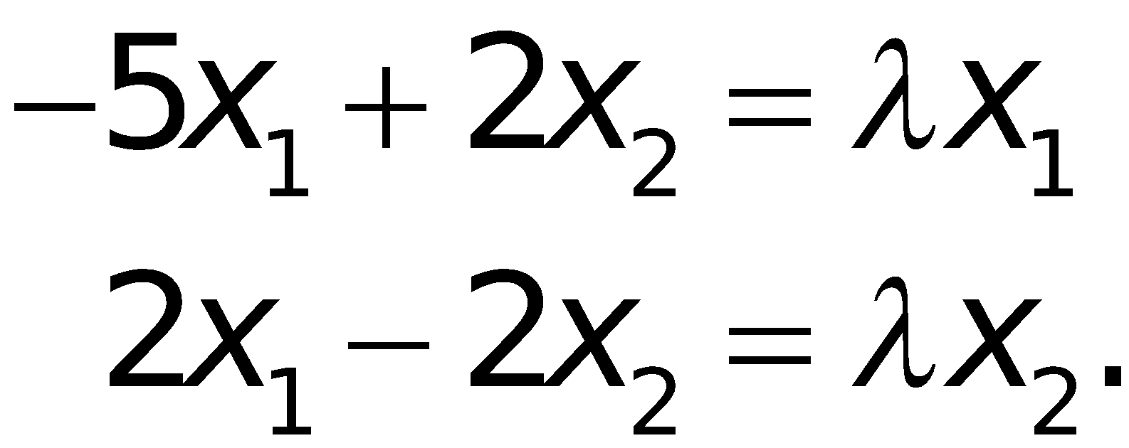
EXAMPLE 1 (continued 1)
Determination of Eigenvalues and Eigenvectors
Solution.
(a) Eigenvalues. These must be determined first.
Equation (1) is
in components
Section 8.1 p‹#›

Slide 8
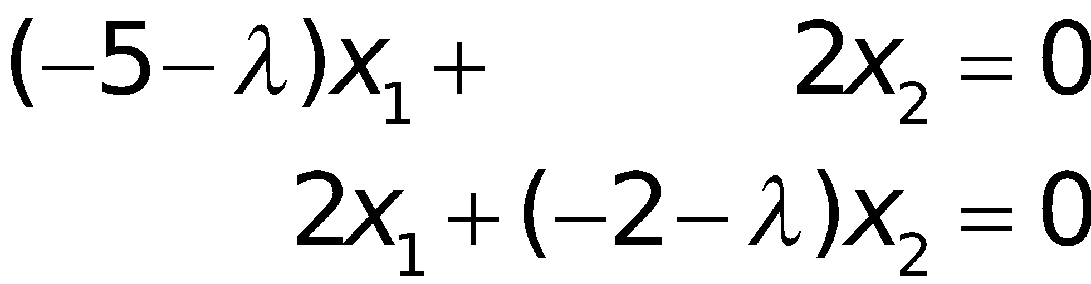

EXAMPLE 1 (continued 2)
Determination of Eigenvalues and Eigenvectors
Solution. (continued 1)
(a) Eigenvalues. (continued 1)
Transferring the terms on the right to the left, we get
(2*)
This can be written in matrix notation
(3*)
Because (1) is Ax − λx = Ax − λIx = (A − λI)x = 0,
which gives (3*).
Section 8.1 p‹#›

Slide 9
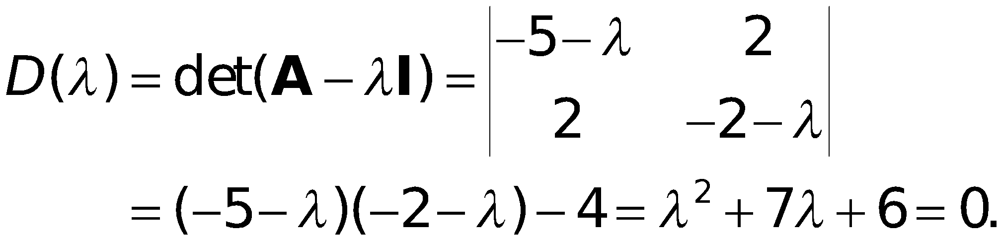
EXAMPLE 1 (continued 3)
Determination of Eigenvalues and Eigenvectors
Solution. (continued 2)
(a) Eigenvalues. (continued 2)
We see that this is a homogeneous linear system. By Cramer’s theorem it has a nontrivial solution (an eigenvector of A we are looking for) if and only if its coefficient determinant is zero, that is,
(4*)
Section 8.1 p‹#›

Slide 10
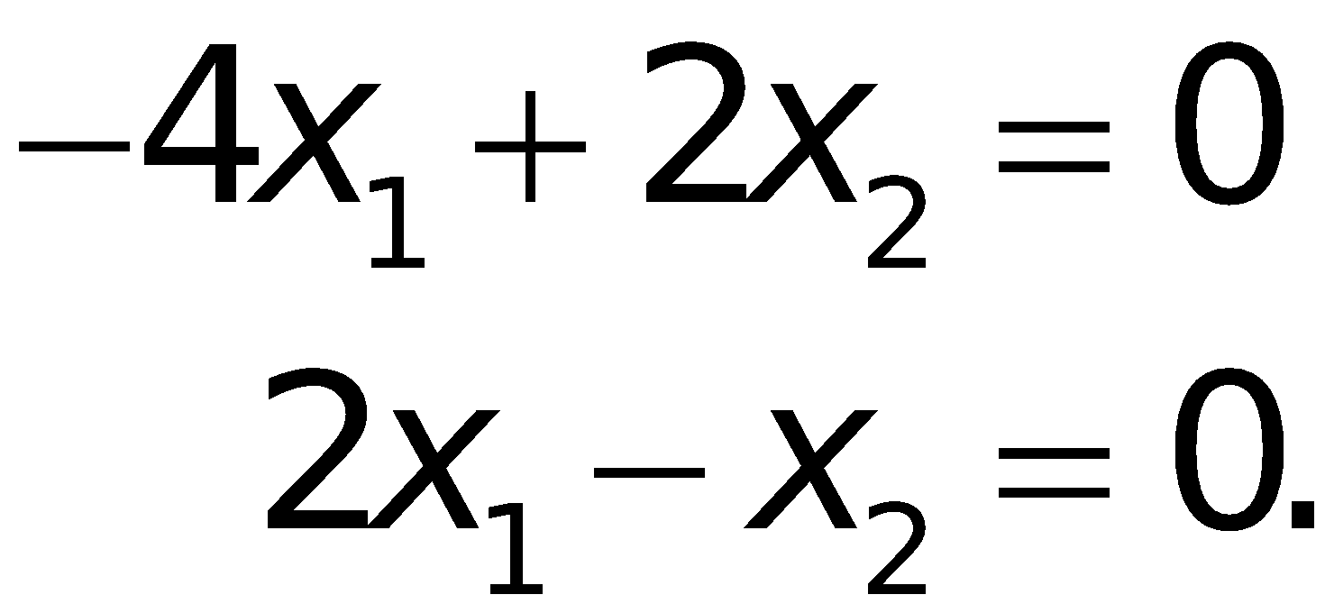
EXAMPLE 1 (continued 4)
Determination of Eigenvalues and Eigenvectors
Solution. (continued 3)
(a) Eigenvalues. (continued 3)
We call D(λ) the characteristic determinant or, if expanded, the characteristic polynomial, and D(λ) = 0 the characteristic equation of A. The solutions of this quadratic equation are λ₁ = −1 and λ₂ = −6. These are the eigenvalues of A.
(b₁) Eigenvector of A corresponding to λ₁. This vector is obtained from (2*) with λ = λ₁ = −1, that is,
Section 8.1 p‹#›

Slide 11
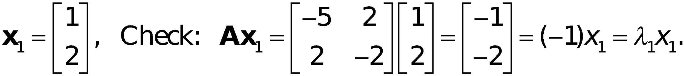
EXAMPLE 1 (continued 5)
Determination of Eigenvalues and Eigenvectors
Solution. (continued 4)
(b₁) Eigenvector of A corresponding to λ₁. (continued)
A solution is x₂ = 2x₁, as we see from either of the two equations, so that we need only one of them. This determines an eigenvector corresponding to λ₁ = −1 up to a scalar multiple. If we choose x₁ = 1, we obtain the eigenvector
Section 8.1 p‹#›

Slide 12
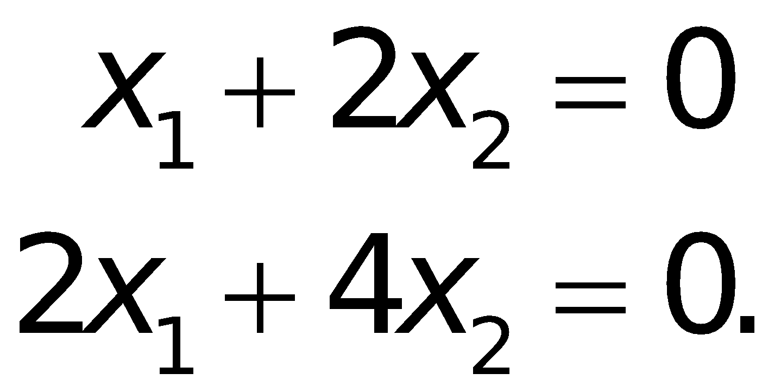
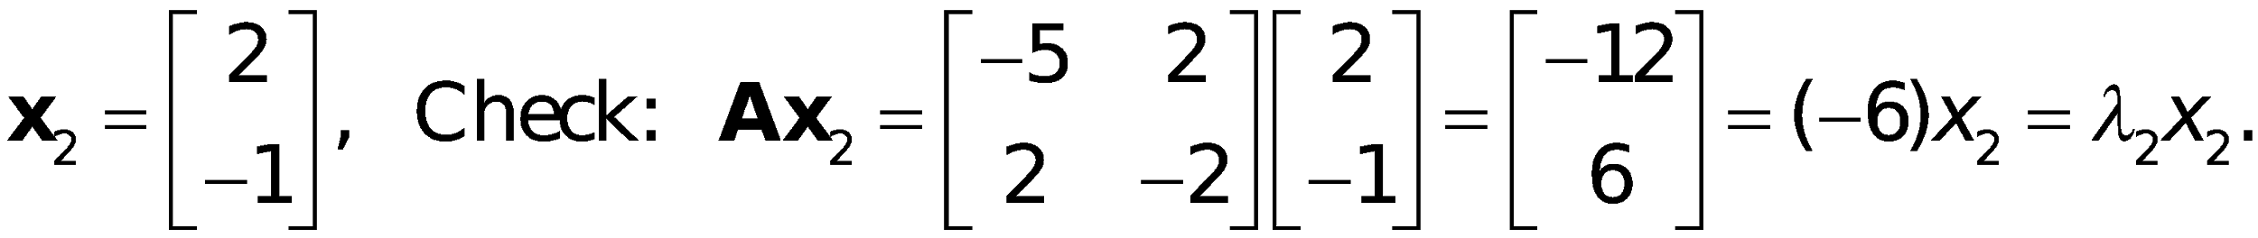
EXAMPLE 1 (continued 6)
Determination of Eigenvalues and Eigenvectors
Solution. (continued 5)
(b₂) Eigenvector of A corresponding to λ₂.
For λ = λ₂ = −6, equation (2*) becomes
A solution is x₂ = −x₁/2 with arbitrary x₁. If we choose x₁ = 2, we get x₂ = −1. Thus an eigenvector of A corresponding to λ₂ = −6 is
Section 8.1 p‹#›

Slide 13
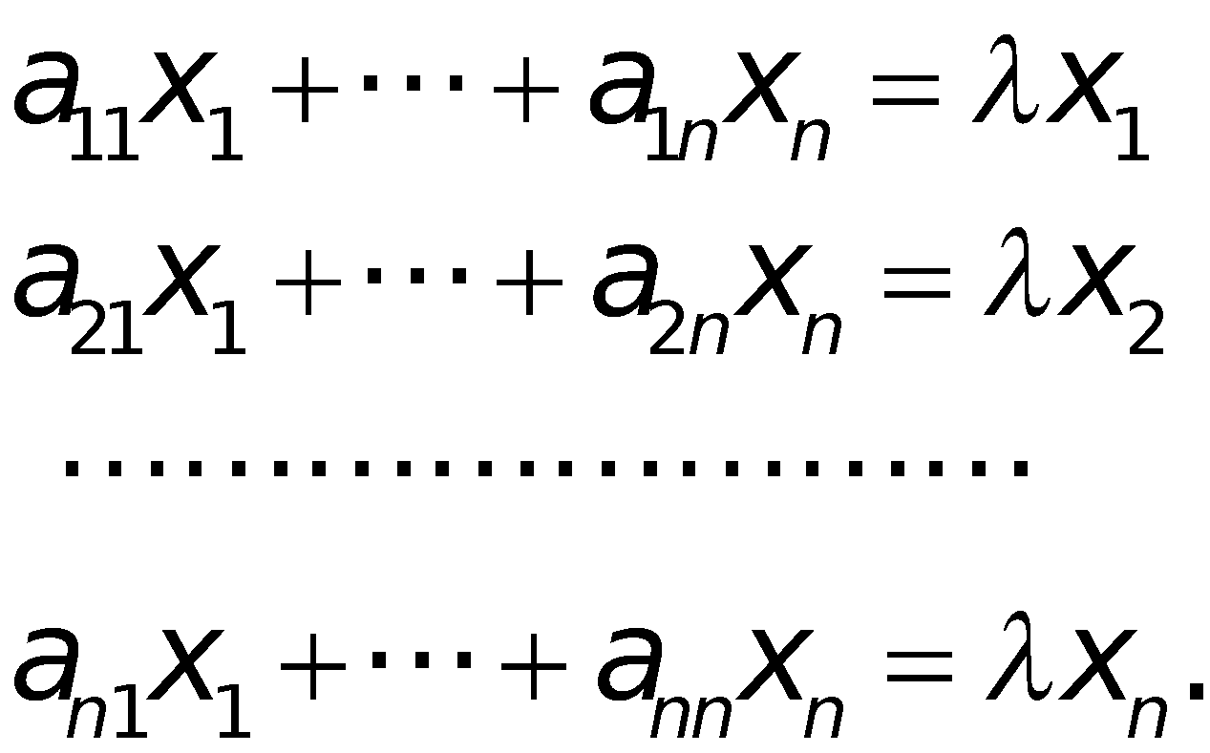
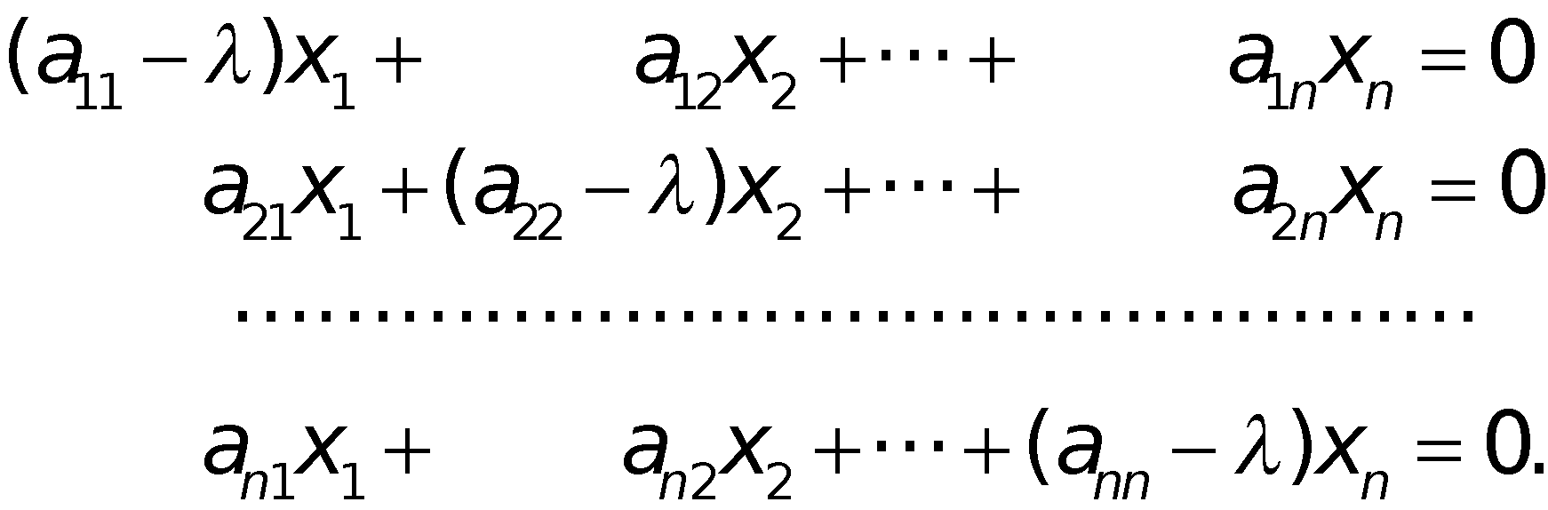
This example illustrates the general case as follows. Equation (1) written in components is
Transferring the terms on the right side to the left side, we have
(2)
Section 8.1 p‹#›

Slide 14

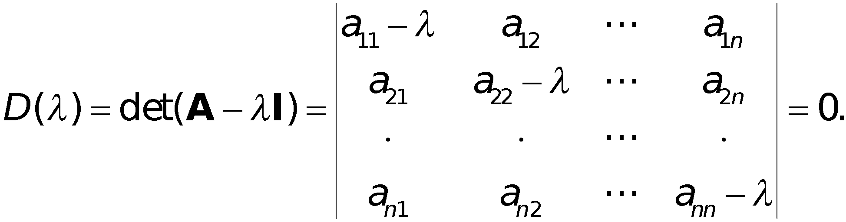
In matrix notation,
(3)
this homogeneous linear system of equations has a nontrivial solution if and only if the corresponding determinant of the coefficients is zero:
(4)
Section 8.1 p‹#›

Slide 15
A − λI is called the characteristic matrix and D(λ) the characteristic determinant of A. Equation (4) is called the characteristic equation of A. By developing D(λ) we obtain a polynomial of nth degree in λ. This is called the characteristic polynomial of A.
Section 8.1 p‹#›

Slide 16
Theorem 1
Eigenvalues
The eigenvalues of a square matrix A are the roots of the characteristic equation (4) of A.
Hence an n × n matrix has at least one eigenvalue and at most n numerically different eigenvalues.
Section 8.1 p‹#›

Slide 17
The eigenvalues must be determined first.
Once these are known, corresponding eigenvectors are obtained from the system (2), for instance, by the Gauss elimination, where λ is the eigenvalue for which an eigenvector is wanted.
Section 8.1 p‹#›

Slide 18
Theorem 2
Eigenvectors, Eigenspace
If w and x are eigenvectors of a matrix A corresponding to the same eigenvalue λ, so are w + x (provided x ≠ −w) and kx for any k ≠ 0.
Hence the eigenvectors corresponding to one and the same eigenvalue λ of A, together with 0, form a vector space (cf. Sec. 7.4), called the eigenspace of A corresponding to that λ.
Section 8.1 p‹#›

Slide 19
In particular, an eigenvector x is determined only up to a constant factor.
Hence we can normalize x, that is, multiply it by a scalar to get a unit vector .
Section 8.1 p‹#›

Slide 20
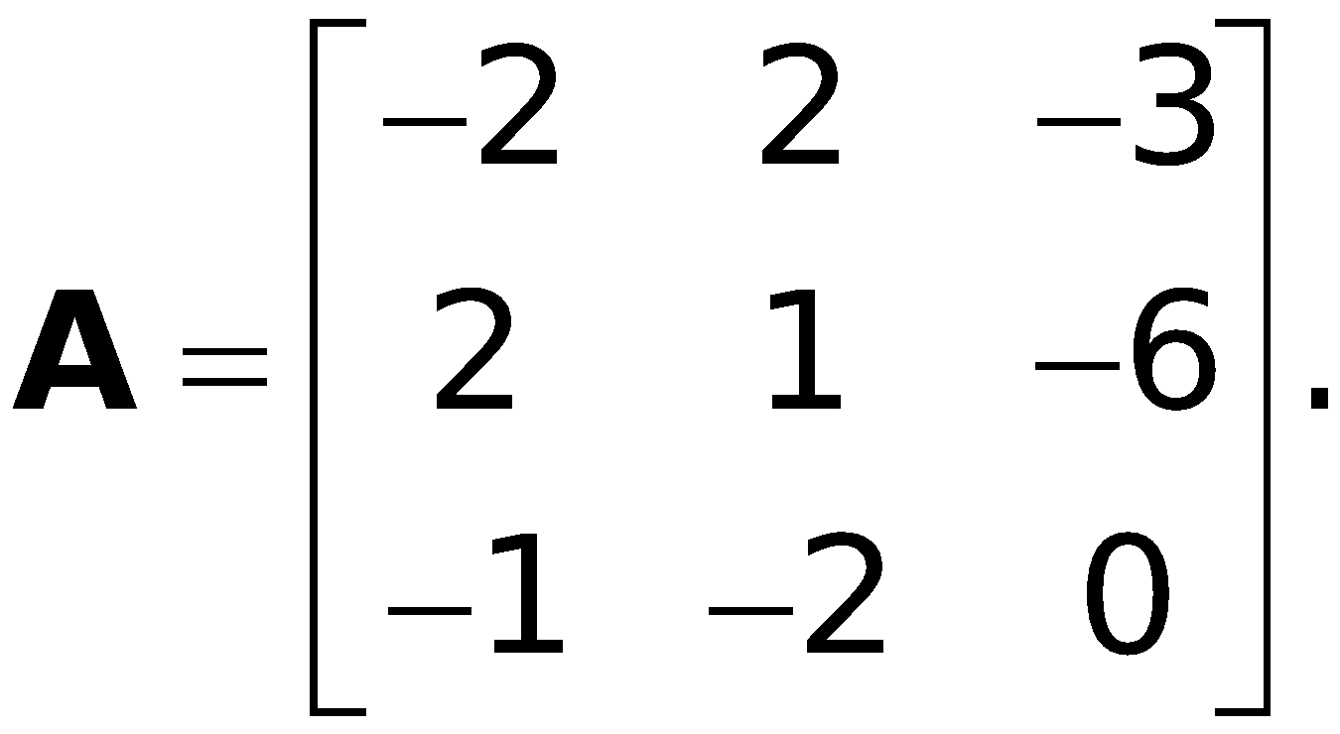
EXAMPLE 2 Multiple Eigenvalues
Find the eigenvalues and eigenvectors of
Section 8.1 p‹#›
Notes:
‹#›

Slide 21
EXAMPLE 2 Multiple Eigenvalues (continued 1)
Solution.
For our matrix, the characteristic determinant gives the characteristic equation
−λ³ − λ² + 21λ + 45 = 0.
The roots (eigenvalues of A) are λ₁ = 5, λ₂ = λ₃ = −3.
(If you have trouble finding roots, you may want to use a root finding algorithm such as Newton’s method (Sec. 19.2). Your CAS or scientific calculator can find roots. However, to really learn and remember this material, you have to do some exercises with paper and pencil.)
Section 8.1 p‹#›

Slide 22
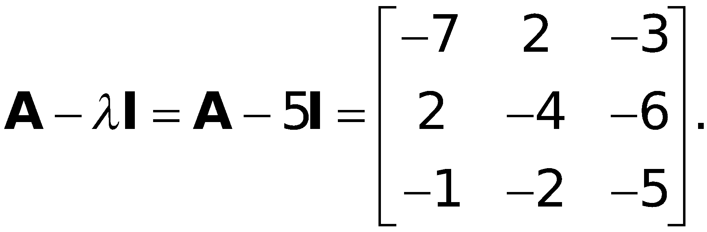
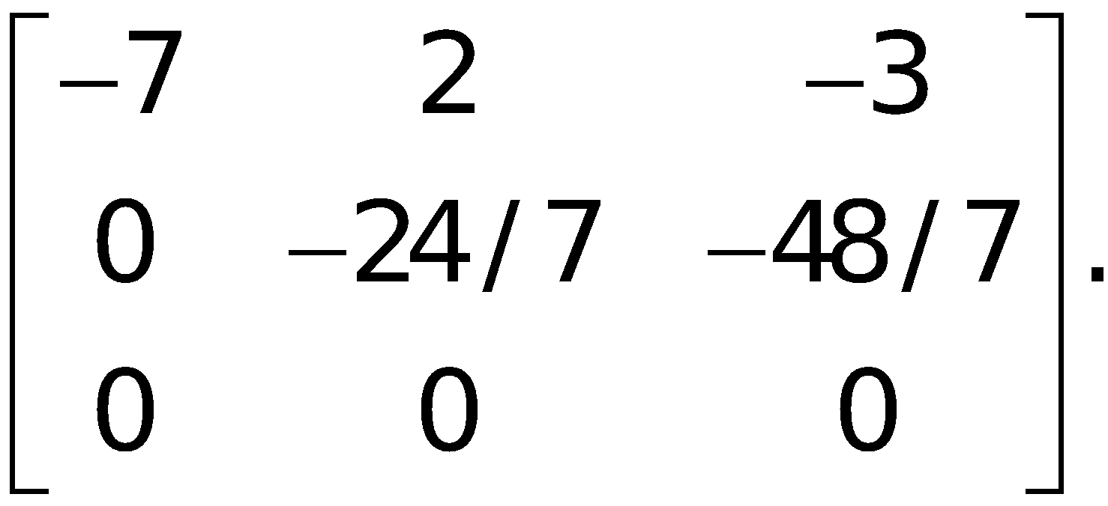
EXAMPLE 2 Multiple Eigenvalues (continued 2)
Solution. (continued 1)
To find eigenvectors, we apply the Gauss elimination (Sec. 7.3) to the system (A − λI)x = 0, first with λ = 5
and then with λ = −3 . For λ = 5 the characteristic matrix is
It row-reduces to
Section 8.1 p‹#›

Slide 23
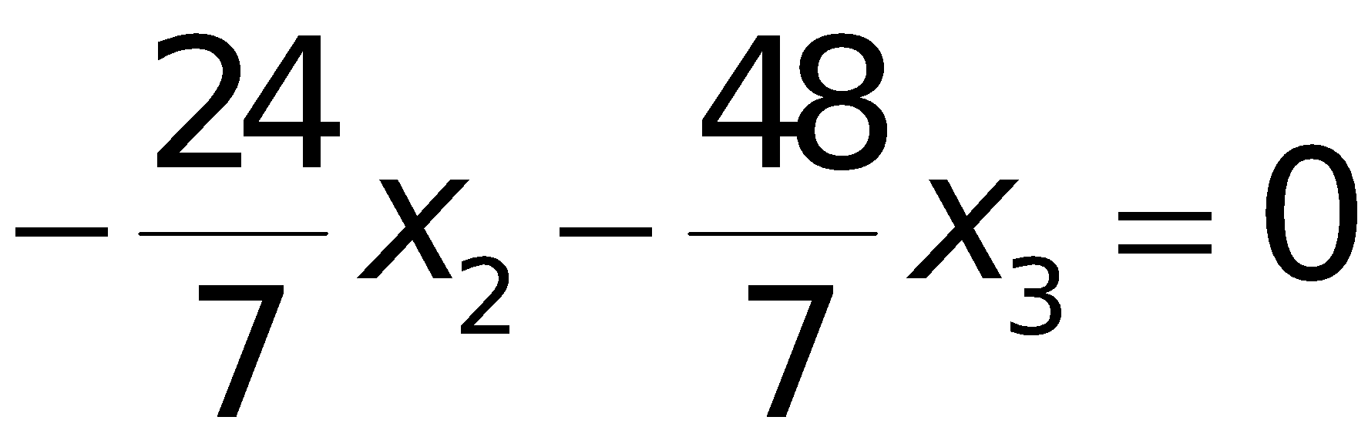
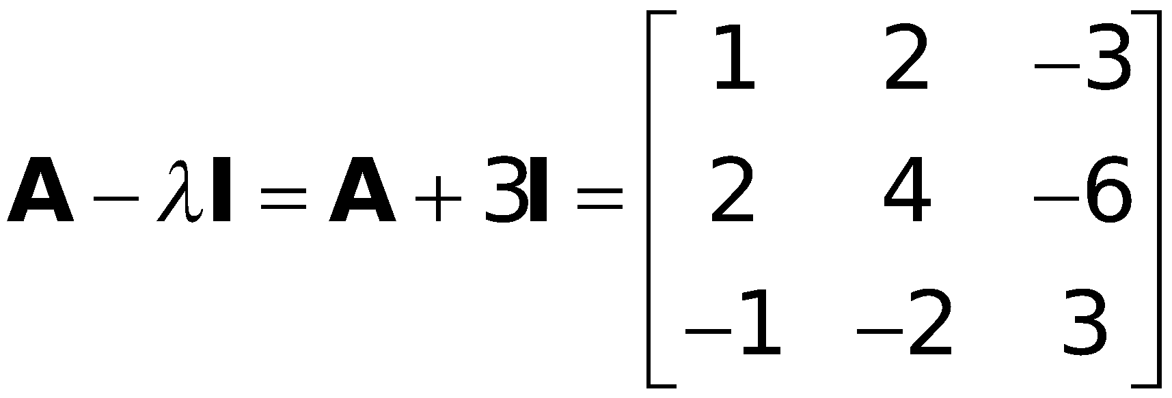
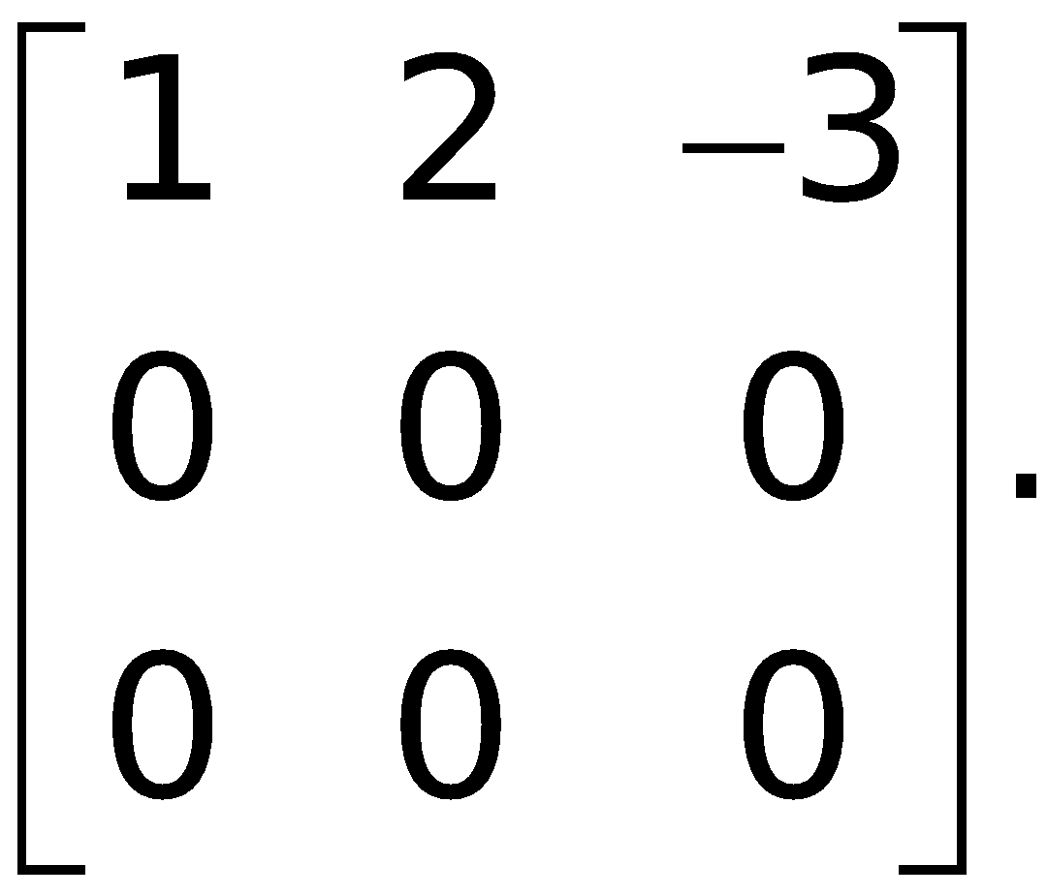
EXAMPLE 2 Multiple Eigenvalues (continued 3)
Solution. (continued 2)
Hence it has rank 2. Choosing x₃ = −1 we have x₂ = 2 from
and then x₁ = 1 from −7x₁ + 2x₂ − 3x₃ = 0.
Hence an eigenvector of A corresponding to λ = 5 is
x₁ = [1 2 −1]^{T}.
For λ = −3 the characteristic matrix
row-reduces to
Section 8.1 p‹#›

Slide 24
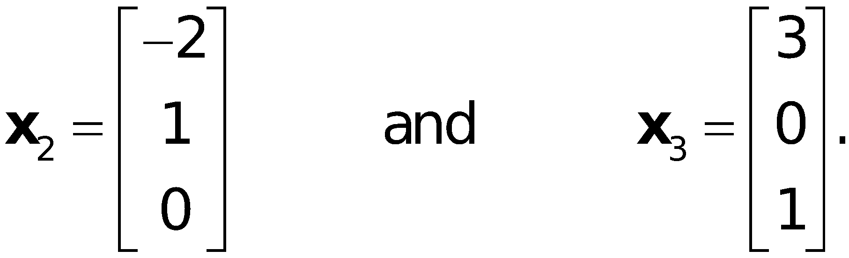
EXAMPLE 2 Multiple Eigenvalues (continued 4)
Solution. (continued 3)
Hence it has rank 1.
From x₁ + 2x₂ − 3x₃ = 0 we have x₁ = −2x₂ + 3x₃. Choosing
x₂ = 1, x₃ = 0 and x₂ = 0, x₃ = 1, we obtain two linearly independent eigenvectors of A corresponding to λ = −3 [as they must exist by (5), Sec. 7.5, with rank = 1 and n = 3],
Section 8.1 p‹#›

Slide 25
The order M_{λ} of an eigenvalue λ as a root of the characteristic polynomial is called the algebraic multiplicity of λ. The number m_{λ} of linearly independent eigenvectors corresponding to λ is called the geometric multiplicity of λ. Thus m_{λ} is the dimension of the eigenspace corresponding to this λ.
Since the characteristic polynomial has degree n, the sum of all the algebraic multiplicities must equal n. In Example 2 for λ = −3 we have m_{λ} = M_{λ} = 2. In general, m_{λ} ≤ M_{λ}, as can be shown. The difference Δ_{λ} = M_{λ} − m_{λ} is called the defect of λ. Thus Δ₋₃ = 0 in Example 2, but positive defects Δ_{λ} can easily occur.
Section 8.1 p‹#›

Slide 26
Theorem 3
Eigenvalues of the Transpose
The transpose A^{T} of a square matrix A has the same eigenvalues as A.
Section 8.1 p‹#›

Slide 27
Symmetric, Skew-Symmetric,
and Orthogonal Matrices
Section 8.3 p‹#›
Notes:
‹#›

Slide 28
Definitions
Symmetric, Skew-Symmetric, and Orthogonal Matrices
A real square matrix A = [a_{jk}] is called
symmetric if transposition leaves it unchanged,
(1) A^{T} = A, thus a_{kj} = a_{jk},
skew-symmetric if transposition gives the negative of A,
(2) A^{T} = −A, thus a_{kj} = −a_{jk},
orthogonal if transposition gives the inverse of A,
(3) A^{T} = A⁻¹.
Section 8.3 p‹#›

Slide 29
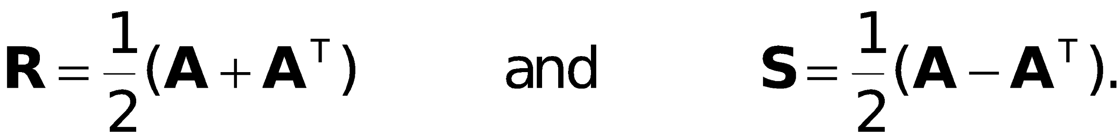
Any real square matrix A may be written as the sum of a symmetric matrix R and a skew-symmetric matrix S, where
(4)
Section 8.3 p‹#›

Slide 30
Theorem 1
Eigenvalues of Symmetric
and Skew-Symmetric Matrices
(a) The eigenvalues of a symmetric matrix are real.
(b) The eigenvalues of a skew-symmetric matrix are pure imaginary or zero.
Section 8.3 p‹#›

Slide 31

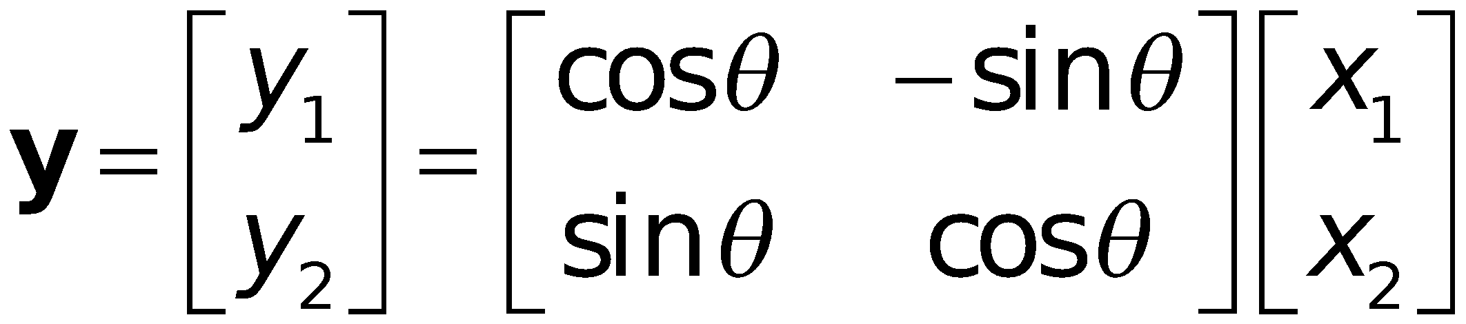
Orthogonal Transformations
and Orthogonal Matrices
Orthogonal transformations are transformations
(5) y = Ax where A is an orthogonal matrix.
With each vector x in R^{n} such a transformation assigns a vector y in R^{n}. For instance, the plane rotation through an angle θ
(6)
is an orthogonal transformation.
Section 8.3 p‹#›

Slide 32
Orthogonal Transformations
and Orthogonal Matrices (continued)
It can be shown that any orthogonal transformation in the plane or in three-dimensional space is a rotation (possibly combined with a reflection in a straight line or a plane, respectively).
The main reason for the importance of orthogonal matrices is as follows.
Section 8.3 p‹#›

Slide 33
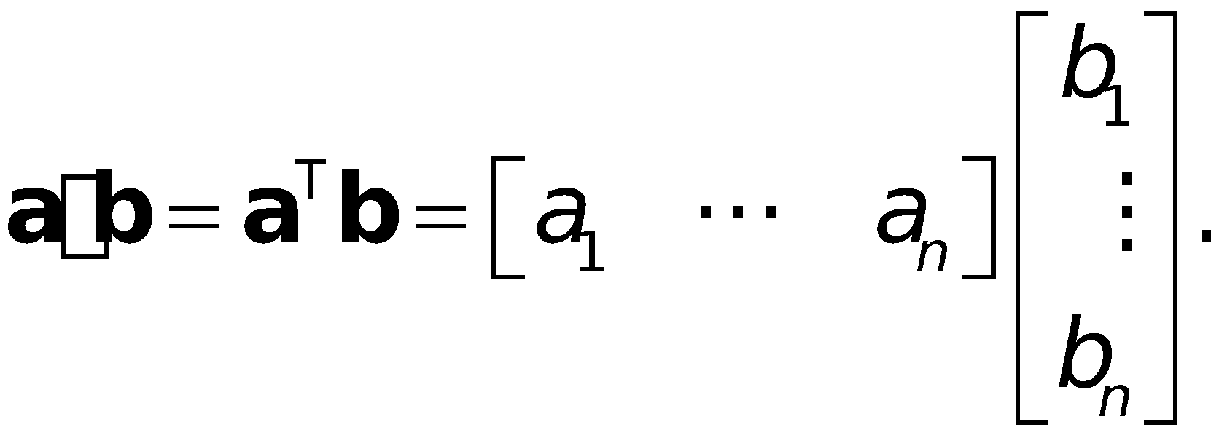

Theorem 2
Invariance of Inner Product
An orthogonal transformation preserves the value of the inner product of vectors a and b in R^{n}, defined by
(7)
That is, for any a and b in R^{n}, orthogonal n × n matrix A, and
u = Aa, v = Ab we have u · v = a · b.
Hence the transformation also preserves the length or norm of any vector a in R^{n} given by
(8)
Section 8.3 p‹#›

Slide 34
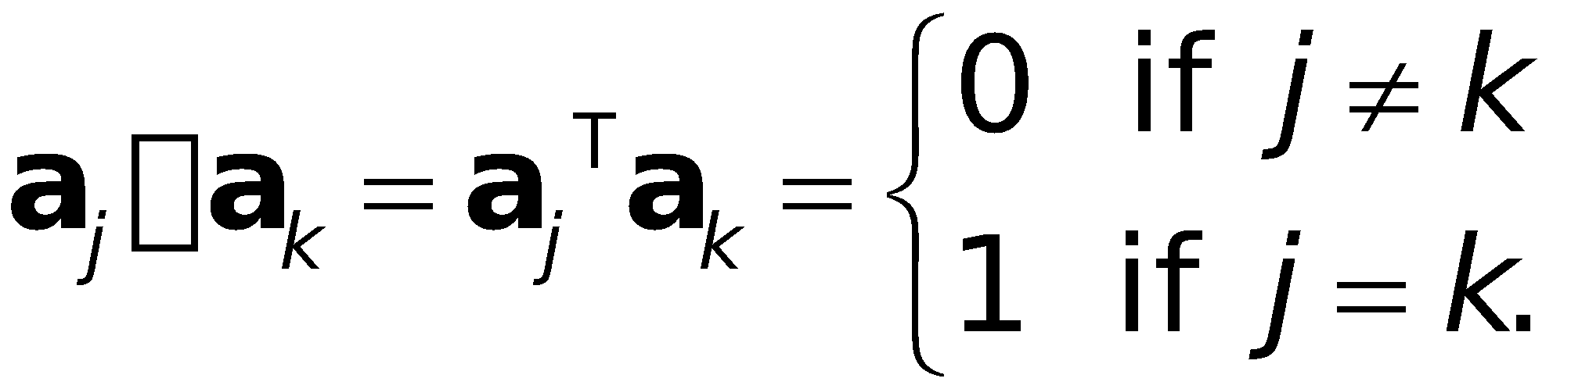
Theorem 3
Orthonormality of Column and Row Vectors
A real square matrix is orthogonal if and only if its column vectors a₁, … , a_{n} (and also its row vectors) form an orthonormal system, that is,
(10)
Section 8.3 p‹#›

Slide 35
Theorem 4
Determinant of an Orthogonal Matrix
The determinant of an orthogonal matrix has the value +1 or −1.
Section 8.3 p‹#›

Slide 36
Theorem 5
Eigenvalues of an Orthogonal Matrix
The eigenvalues of an orthogonal matrix A are real or complex conjugates in pairs and have absolute value 1.
Section 8.3 p‹#›

